Slide 1
Invoice Dependency Diagram
COMPOSITE PRIMARY KEY
INV_NUM + PROD_NUM
Full dependency
PROD_NUM
INV_NUM
QUANT_SOLD
Partial
Partial
Partial dependency
PROD_LABEL
PROD_PRICE
SALE_DATE
Partial
VEND_CODE
Transitive dependency
VEND_NAME
Legend: Orange = partial dependency Green = full dependency Purple = transitive dependency

Slide 2
The key points to remember are:
Composite Primary Key: (INV_NUM, PROD_NUM)
Partial dependencies:
INV_NUM → SALE_DATE
PROD_NUM → PROD_LABEL, PROD_PRICE, VEND_CODE
Full dependency:
(INV_NUM, PROD_NUM) → QUANT_SOLD
Transitive dependency:
VEND_CODE → VEND_NAME, giving the chain PROD_NUM → VEND_CODE → VEND_NAME
This structure is therefore not in 2NF, because of the partial dependencies, and it is also not in 3NF, because VEND_CODE → VEND_NAME introduces a transitive dependency.
The key points to remember are:
Composite Primary Key: (INV_NUM, PROD_NUM)
Partial dependencies:
INV_NUM → SALE_DATE
PROD_NUM → PROD_LABEL, PROD_PRICE, VEND_CODE
Full dependency:
(INV_NUM, PROD_NUM) → QUANT_SOLD
Transitive dependency:
VEND_CODE → VEND_NAME, giving the chain PROD_NUM → VEND_CODE → VEND_NAME
This structure is therefore not in 2NF, because of the partial dependencies, and it is also not in 3NF, because VEND_CODE → VEND_NAME introduces a transitive dependency.

Slide 3
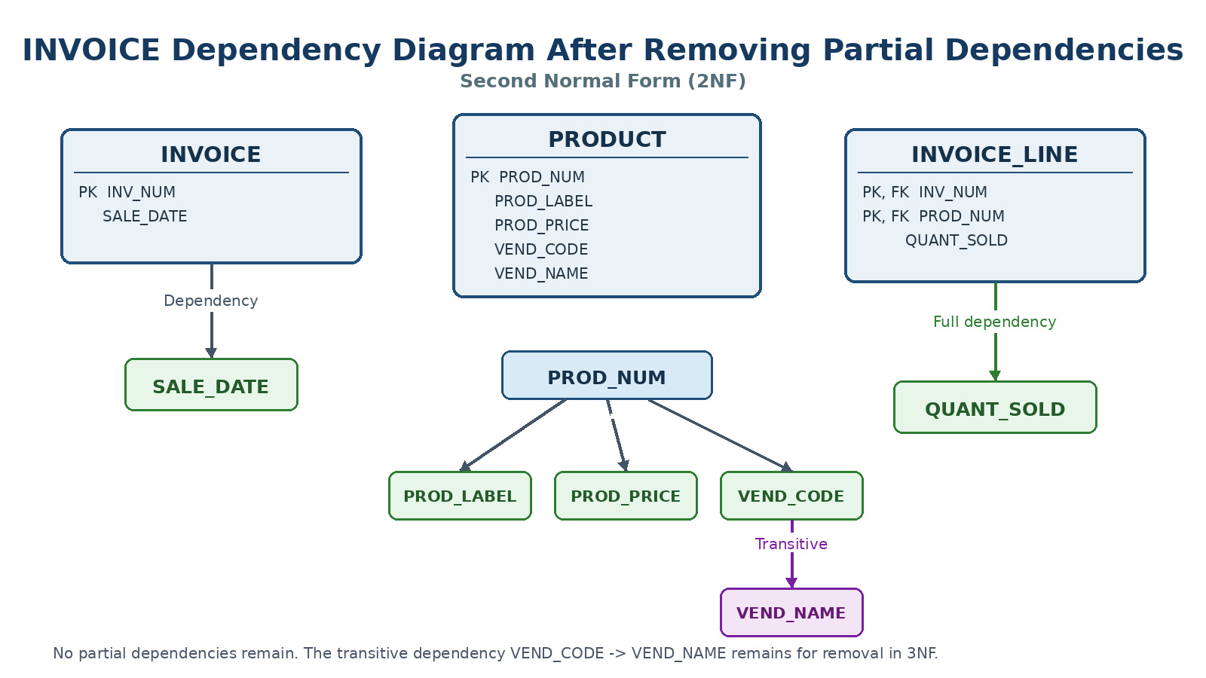

Slide 4
INVOICE Dependency Diagram After Removing Partial Dependencies
Second Normal Form (2NF)
PRODUCT
PK PROD_NUM
PROD_LABEL
PROD_PRICE
VEND_CODE
VEND_NAME
INVOICE
PK INV_NUM
SALE_DATE
INVOICE_LINE
PK, FK INV_NUM
PK, FK PROD_NUM
QUANT_SOLD
Dependency
Full dependency
SALE_DATE
PROD_NUM
QUANT_SOLD
PROD_LABEL
PROD_PRICE
VEND_CODE
Transitive
VEND_NAME
No partial dependencies remain. The transitive dependency VEND_CODE -> VEND_NAME remains for removal in 3NF.

Slide 5
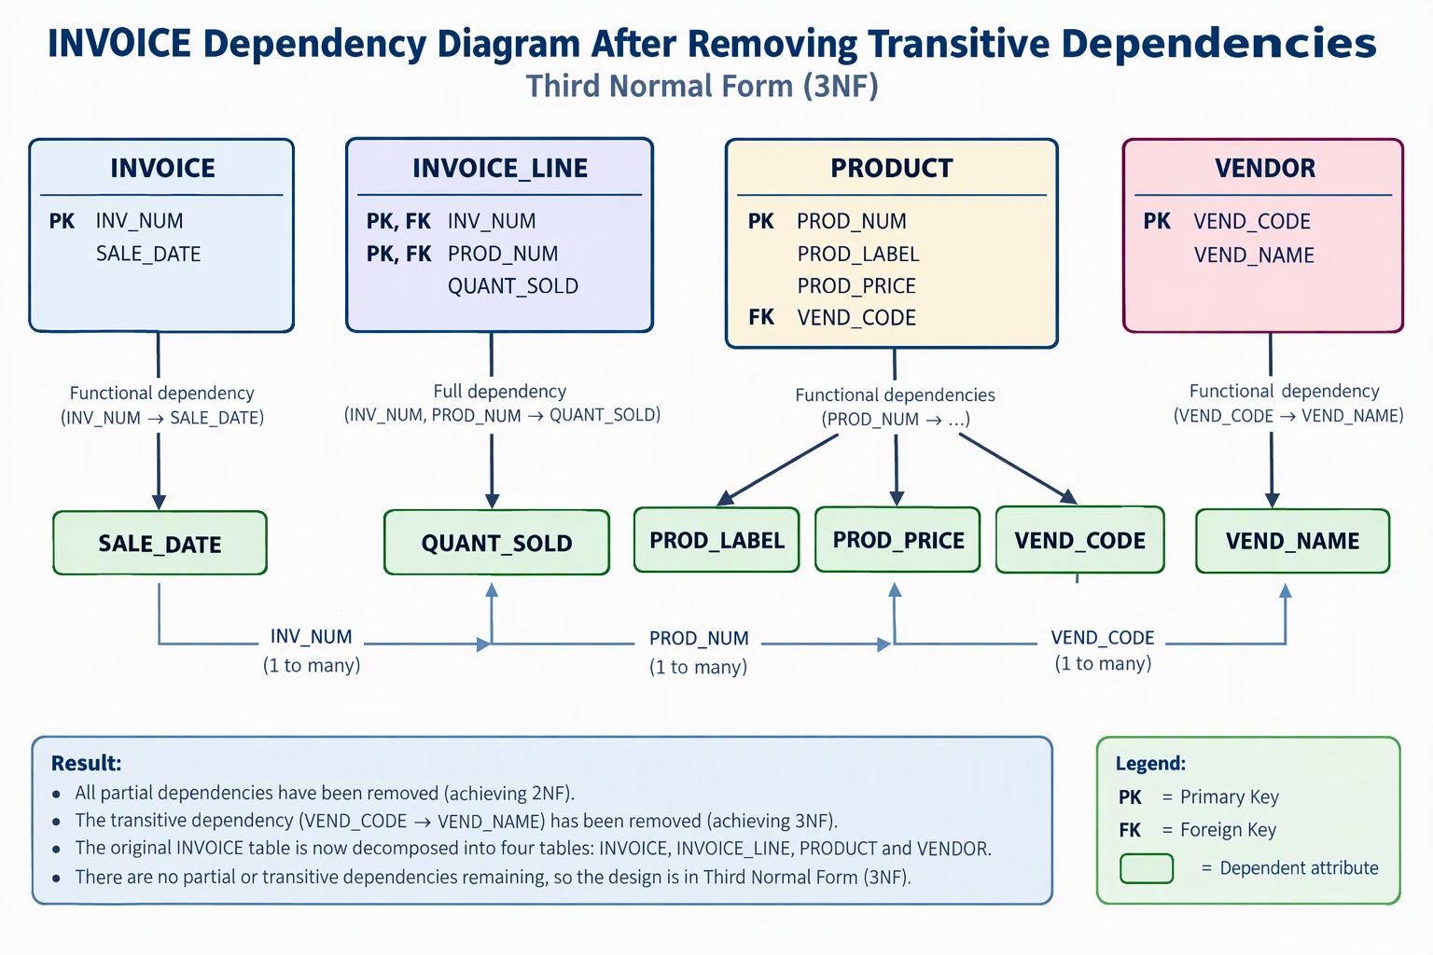

Slide 6
INVOICE Dependency Diagram After Removing Transitive Dependencies
Third Normal Form (3NF)
INVOICE
PK INV_NUM
SALE_DATE
INVOICE_LINE
PK, FK INV_NUM
PK, FK PROD_NUM
QUANT_SOLD
PRODUCT
PK PROD_NUM
PROD_LABEL
PROD_PRICE
FK VEND_CODE
VENDOR
PK VEND_CODE
VEND_NAME
Functional dependencies
(PROD_NUM → …)
Functional dependency
(INV_NUM → SALE_DATE)
Full dependency
(INV_NUM, PROD_NUM → QUANT_SOLD)
Functional dependency
(VEND_CODE → VEND_NAME)
SALE_DATE
QUANT_SOLD
PROD_LABEL
PROD_PRICE
VEND_CODE
VEND_NAME
INV_NUM
(1 to many)
PROD_NUM
(1 to many)
VEND_CODE
(1 to many)
Result:
All partial dependencies have been removed (achieving 2NF).
The transitive dependency (VEND_CODE → VEND_NAME) has been removed (achieving 3NF).
The original INVOICE table is now decomposed into four tables: INVOICE, INVOICE_LINE, PRODUCT and VENDOR.
There are no partial or transitive dependencies remaining, so the design is in Third Normal Form (3NF).
Legend:
PK = Primary Key
FK = Foreign Key
▢ = Dependent attribute

